Slide 1
Chapter 2: The Project Management and Information Technology Context
Information Technology Project Management, Ninth Edition
Note: See the text itself for full citations.

Slide 2
Learning Objectives (1 of 2)
Define the systems view of project management and how it applies to information technology (IT) projects
Summarize organizations, including the four frames, organizational structures, and organizational culture
Explain why stakeholder management and top management commitment are critical for a project’s success

Slide 3
Learning Objectives (2 of 2)
Distinguish between project and product life cycles
Discuss the unique attributes and diverse nature of IT projects
Summarize recent trends affecting IT project management, including globalization, outsourcing, virtual teams, and agile project management

Slide 4
A Systems View of Project Management
Projects must operate in a broad organizational environment
Project managers need to use systems thinking:
Taking a holistic view of carrying out projects within the context of the organization
What Is a Systems Approach?
A systems approach emerged in the 1950s to describe a holistic and analytical approach to management and problem solving
Three parts include:
Systems philosophy: an overall model for thinking about things as systems
Systems analysis: problem-solving approach
Systems management: address business, technological, and organizational issues before making changes to systems

Slide 5
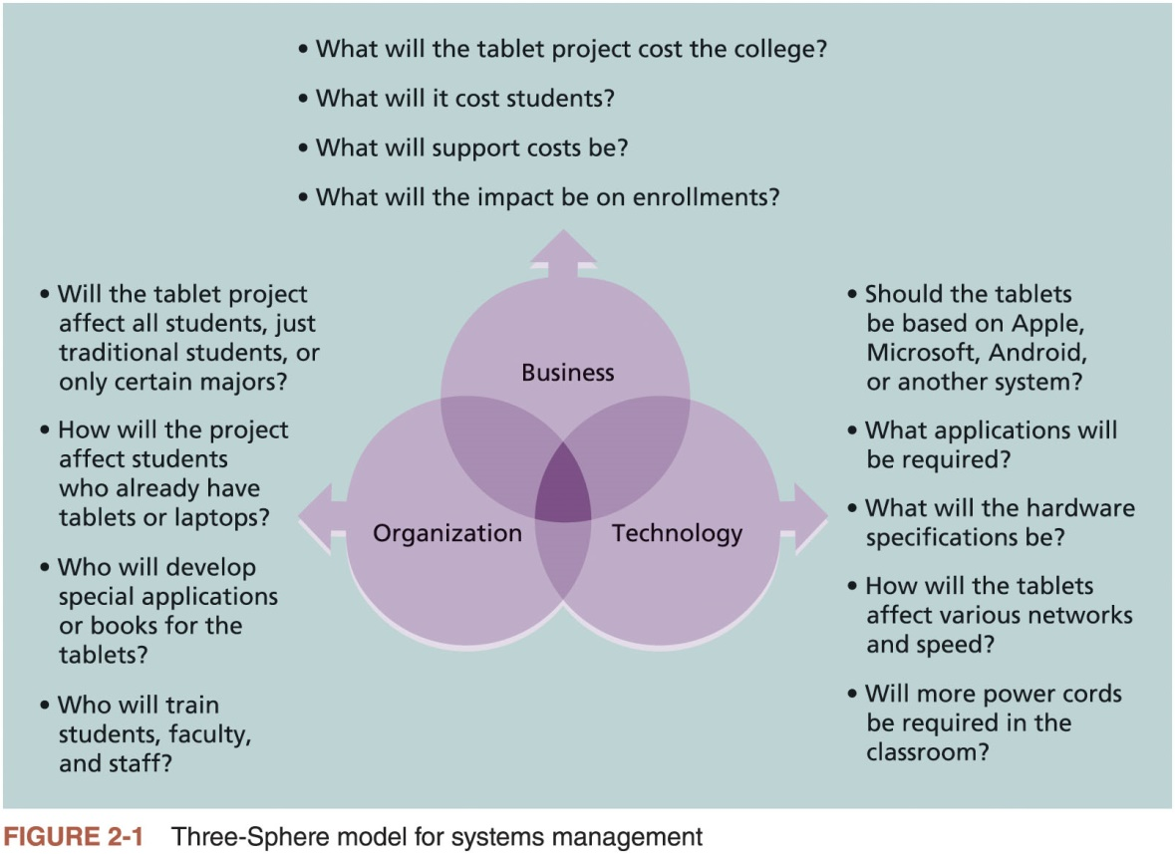
The Three-Sphere Model for Systems Management

Slide 6
Understanding Organizations
Systems approach requires that project managers always view their projects in the context of the larger organization
Organizational issues are often the most difficult part of working on and managing projects
Important for project managers to develop a better understanding of people as well as organizations
To improve the success rate of IT projects

Slide 7
Advice for Young Professionals
It’s difficult enough trying to understand the various technologies an organization uses. How can you begin to understand the business and organizational aspects?
Make it a priority. Don’t just focus on the technology, no matter how exciting it seems to you. Even if you take just a few minutes each day learning about other aspects of the organization, that’s a start.
Tell your boss or other people you work with that you want to understand how the entire organization works. Ask important questions like how the company makes money, who key customers are, what the priorities are for the year, what meetings you can attend or documents you can read to gain more knowledge, etc.
Network, network, network! Find out which people inside or outside of your organization can help you in developing a systems approach. You might be surprised how quickly you can move up in your career once you understand the big picture.

Slide 8
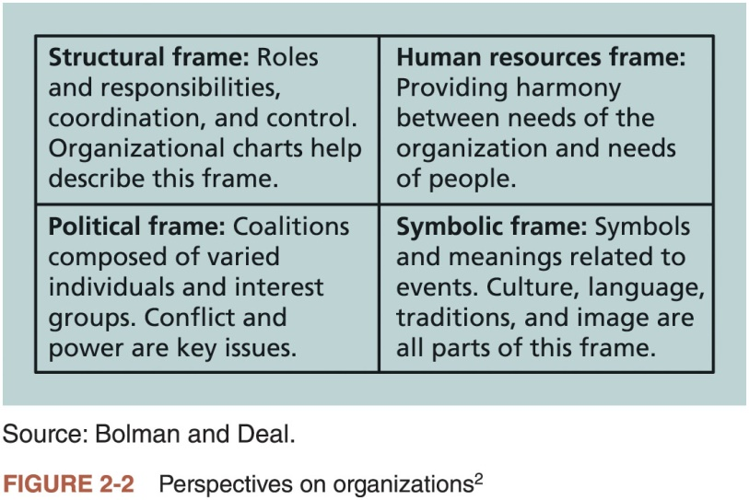
The Four Frames of Organizations

Slide 9
Organizational Structures (1 of 2)
Three basic organizational structures
Functional: functional managers report to the CEO
Project: program managers report to the CEO
Matrix: middle ground between functional and project structures; personnel often report to two or more bosses; structure can be weak, balanced, or strong matrix

Slide 10
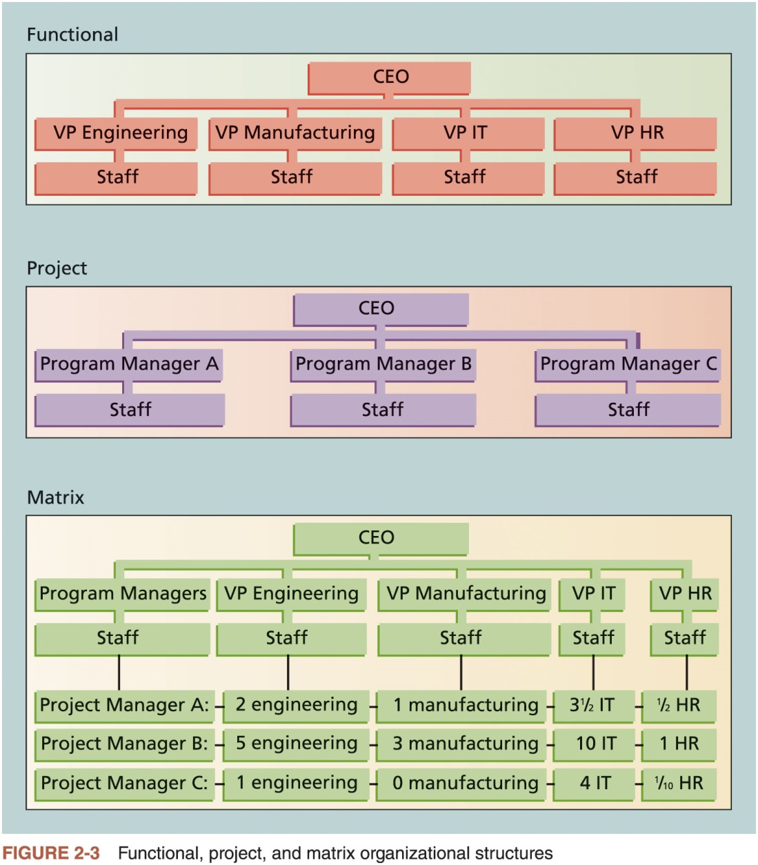
Organizational Structures (2 of 2)

Slide 11
Organizational Culture (1 of 2)
Organizational culture is a set of shared assumptions, values, and behaviors that characterize the functioning of an organization
Many experts believe the underlying causes of many companies’ problems are not the structure or staff, but the culture

Slide 12
Organizational Culture (2 of 2)
Ten characteristics of organizational culture:
Member identity*
Group emphasis*
People focus
Unit integration*
Control
Risk tolerance*
Reward criteria*
Conflict tolerance*
Means-ends orientation
Open-systems focus*
*Project work is most successful in an organizational culture where these items are strong/high and other items are balanced.

Slide 13
Focusing on Stakeholder Needs
Project managers must take time to identify, understand, and manage relationships with all project stakeholders
Using the four frames of organizations can help meet stakeholder needs and expectations
Senior executives/top management are very important stakeholders
See Chapter 13, Project Stakeholder Management, for more information

Slide 14
The Importance of Top Management Commitment (1 of 2)
People in top management positions are key stakeholders in projects
A very important factor in helping project managers successfully lead projects is the level of commitment and support they receive from top management
Without top management commitment, many projects will fail.
Some projects have a senior manager called a champion who acts as a key proponent for a project.

Slide 15
The Importance of Top Management Commitment (2 of 2)
How top management can help project managers
Providing adequate resources
Approving unique project needs in a timely manner
Getting cooperation from other parts of the organization
Mentoring and coaching on leadership issues

Slide 16
The Need for Organizational Commitment to Information Technology
If the organization has a negative attitude toward IT, it will be difficult for an IT project to succeed
Having a Chief Information Officer (CIO) at a high level in the organization helps IT projects
Assigning non-IT people to IT projects also encourage more commitment

Slide 17
The Need for Organizational Standards
Standards and guidelines help project managers be more effective
Senior management can encourage
the use of standard forms and software for project management
the development and use of guidelines for writing project plans or providing status information
the creation of a project management office or center of excellence

Slide 18
Project and Product Life Cycles
It is good practice to divide projects into several phases
Because projects operate as part of a system and involve uncertainty
The same can be said for developing products

Slide 19
Project Life Cycle (1 of 2)
A project life cycle is a collection of project phases that defines
what work will be performed in each phase
what deliverables will be produced and when
who is involved in each phase, and
how management will control and approve work produced in each phase
A deliverable is a product or service produced or provided as part of a project

Slide 20
Project Life Cycle (2 of 2)
In early phases of a project life cycle
resource needs are usually lowest
the level of uncertainty (risk) is highest
project stakeholders have the greatest opportunity to influence the project
In middle phases of a project life cycle
the certainty of completing a project improves
more resources are needed
The final phase of a project life cycle focuses on
ensuring that project requirements were met
the sponsor approves completion of the project

Slide 21
Product Life Cycles (1 of 3)
Products also have life cycles
The Systems Development Life Cycle (SDLC) is a framework for describing the phases of developing information systems
Systems development projects can follow
Predictive life cycle
Iterative life cycle
Incremental life cycle
Adaptive life cycle
Hybrid life cycle

Slide 22
Product Life Cycles (2 of 3)
Predictive Life Cycle Models
Waterfall model: has well-defined, linear stages of systems development and support
Spiral model: shows that software is developed using an iterative or spiral approach rather than a linear approach
Prototyping model: used for developing prototypes to clarify user requirements
Rapid Application Development (RAD) model: used to produce systems quickly without sacrificing quality

Slide 23
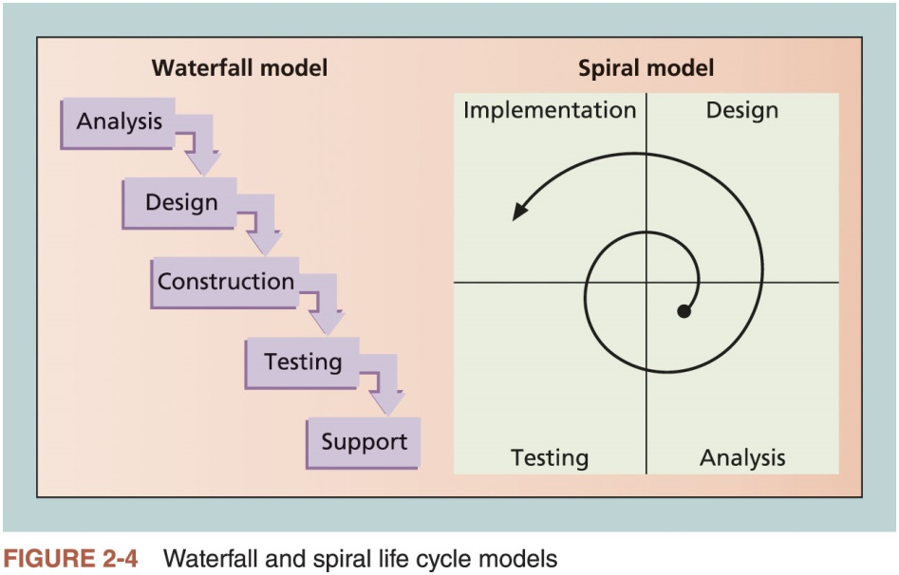
Product Life Cycles (3 of 3)

Slide 24
The Importance of Project Phases and Management Reviews
A project should successfully pass through each of the project phases in order to continue on to the next
Management reviews, also called phase exits, phase gate reviews, or kill points, should occur after each phase to evaluate the project’s progress, likely success, and continued compatibility with organizational goals
It is unwise to wait until the end of project or product phases to have management inputs
Many projects are reviewed by management on a regular basis

Slide 25
The Context of Information Technology Projects
Project context
Has a critical impact on which product development life cycle will be most effective for a particular software development project
Several issues unique to the IT industry have a critical impact on managing IT projects

Slide 26
The Nature of IT Projects
IT projects can be very diverse in terms of size, complexity, products produced, application area, and resource requirements
The nature of software development projects is even more diverse than hardware-oriented projects
IT projects also support every possible industry and business function

Slide 27
Characteristics of IT Project Team Members
IT project team members often have diverse backgrounds and skill sets
Many companies purposely hire graduates with degrees in other fields such as business, mathematics, or the liberal arts to provide different perspectives on IT projects
Some IT projects require the skills of people in just a few job functions
But some require inputs from many or all of them

Slide 28
Diverse Technologies
IT projects use diverse technologies that change rapidly
Differences in technical knowledge can make communication between professionals challenging
New technologies have also shortened the time frame many businesses have to develop, produce, and distribute new products and services

Slide 29
Recent Trends Affecting Information Technology Project Management
Globalization
Outsourcing: Outsourcing is when an organization acquires goods and/or sources from an outside source. Offshoring is sometimes used to describe outsourcing from another country
Virtual teams: A virtual team is a group of individuals who work across time and space using communication technologies
Agile project management

Slide 30
Globalization
Issues
Communications
Trust
Common work practices
Tools
Suggestions
Employ greater project discipline
Think globally but act locally
Consider collaboration over standardization
Keep project momentum going
Use newer tools and technology

Slide 31
Outsourcing
Organizations remain competitive by using outsourcing to their advantage, such as finding ways to reduce costs
Practice can be unpopular on some countries
Project managers should become more familiar with many global and procurement issues

Slide 32
Virtual Teams (1 of 2)
Advantages
Lowering costs because many virtual workers do not require office space or support beyond their home offices
Providing more expertise and flexibility or increasing competitiveness and responsiveness by having team members from across the globe working any time of day or night
Improving the work/life balance for team members by eliminating fixed office hours and the need to travel to work

Slide 33
Virtual Teams (2 of 2)
Disadvantages
Isolating team members
Increasing the potential for communications problems
Reducing the ability for team members to network and transfer information informally
Increasing the dependence on technology to accomplish work
See text for a list of factors that help virtual teams succeed, including team processes, trust/relationships, leadership style, and team member selection

Slide 34
Agile (1 of 2)
Agile means being able to move quickly and easily, but some people feel that project management, as they have seen it used, does not allow people to work quickly or easily
Early software development projects often used a waterfall approach
As technology and businesses became more complex, the approach was often difficult to use because requirements were unknown or continuously changing
Agile today means using an approach where requirements and solutions evolve through collaboration

Slide 35
Agile (2 of 2)
Manifesto for Agile Software Development
In February 2001, a group of 17 people that called itself the Agile Alliance developed and agreed on the Manifesto for Agile Software Development, as follows:
“We are uncovering better ways of developing software by doing it and helping others do it. Through this work we have come to value:
Individuals and interactions over processes and tools
Working software over comprehensive documentation
Customer collaboration over contract negotiation
Responding to change over following a plan”*
*Agile Manifesto.

Slide 36
Scrum (1 of 4)
According to the Scrum Alliance, Scrum is the leading agile development method for completing projects with a complex, innovative scope of work.
The term was coined in 1986 in a Harvard Business Review study that compared high-performing, cross-functional teams to the scrum formation used by rugby teams.

Slide 37
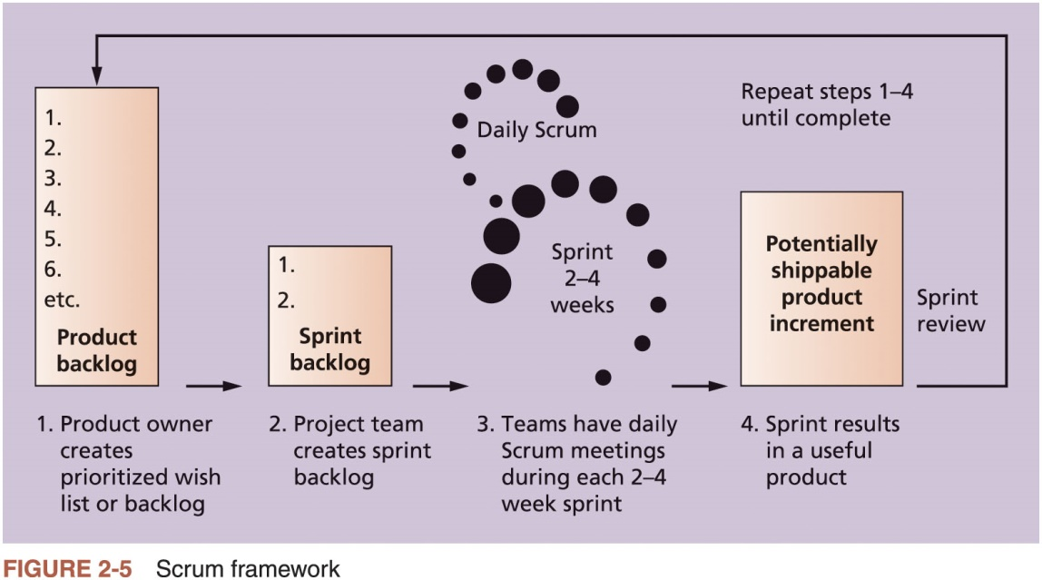
Scrum (2 of 4)

Slide 38
Scrum (3 of 4)
Kanban
Technique that can be used in conjunction with Scrum
Developed in Japan by Toyota Motor Corporation
Uses visual cues to guide workflow
Kanban cards show new work, work in progress, and work completed

Slide 39
Scrum (4 of 4)
The PMBOK® Guide describes best practices for what should be done to manage projects.
Agile is a methodology that describes how to manage projects.
The Project Management Institute (PMI) recognized the increased interest in Agile, and introduced a new certification in 2011 called Agile Certified Practitioner (ACP).
Seasoned project managers understand that they have always had the option of customizing how they run projects, but that project management is not easy, even when using Agile.

Slide 40
Chapter Summary
Project managers need to take a systems approach when working on projects
Organizations have four different frames: structural, human resources, political, and symbolic
The structure and culture of an organization have strong implications for project managers
Projects should successfully pass through each phase of the project life cycle
Project managers need to consider several factors due to the unique context of information technology projects
Recent trends affecting IT project management include globalization, outsourcing, virtual teams, and agile project management

